Slide 1

Netflix Data Engineering Pipeline: ETL and Analytics System
Department of CSE
COURSE: FUNDAMENTALS OF DATA ENGINEERING – (24DEA3101)
SECTION-4
Review-1
Team-10
Under the Guidance of: DR.N Shirisha
Team Members
2420030332-K.Bhavana
2420030471-N.Nikitha Reddy
2420030119-C.Akshara

Slide 2
ABSTRACT
The Netflix Data Engineering Pipeline is an end-to-end data engineering and analytics system developed to process Netflix movies and TV shows data. The pipeline automates data ingestion, cleaning, validation, transformation, storage, analytics, and recommendation generation.
The raw Netflix dataset is processed using Python and Pandas, followed by PySpark-based transformation and feature engineering. The processed data is stored in MongoDB, while analytical processing generates insights related to content type, ratings, countries, genres, and release years.
A content-based recommendation system is implemented using Scikit-learn to identify similar Netflix titles. Apache Airflow is used to orchestrate the complete seven-stage pipeline, and Docker provides a containerized environment for workflow execution.
Finally, Power BI is used to create an interactive dashboard for visualizing the analytical results and presenting meaningful insights from the Netflix dataset.

Slide 3
INTRODUCTION
In today's digital world, organizations generate and collect large amounts of data from various sources. However, raw data often contains missing values, inconsistent information, and unstructured records, making it difficult to analyze. Data engineering plays an important role in collecting, cleaning, transforming, storing, and preparing data for analysis and decision-making.
Netflix provides a large dataset containing information about movies and TV shows, including title, content type, country, release year, rating, duration, genre, and description.
This project develops an end-to-end data engineering pipeline that transforms raw Netflix data into structured, validated, and analytical information.
The system integrates Python, Pandas, PySpark, MongoDB, Scikit-learn, Apache Airflow, Docker, and Power BI to demonstrate the complete data engineering workflow from raw data ingestion to visualization and recommendation.

Slide 4
OBJECTIVES
To develop an end-to-end Netflix data engineering pipeline.
To ingest and clean raw Netflix dataset using Python and Pandas.
To validate data quality and handle missing or inconsistent values.
To transform and engineer features using PySpark.
To store processed data in MongoDB.
To perform analytical processing on Netflix content.
To develop a content-based recommendation system using Scikit-learn.
To orchestrate the complete pipeline using Apache Airflow.
To visualize analytical results using Microsoft Power BI.

Slide 5
LITERATURE SURVEY
No. | Authors / Year | Paper Title | Methodology | Key Inference | Limitation / Future Work
1 | Gómez-Uribe & Hunt (2015) | The Netflix Recommender System: Algorithms, Business Value, and Innovation | Uses large-scale user interaction data, recommendation algorithms, offline experiments and A/B testing. | Data-driven recommendation systems can improve user engagement and retention. | Requires continuous experimentation and large-scale data processing. (DOI)
2 | Steck et al. (2021) | Deep Learning for Recommender Systems: A Netflix Case Study | Applies deep-learning models to heterogeneous Netflix user and content data for personalized ranking. | Deep learning becomes more effective when diverse features are incorporated into the data pipeline. | Offline and online performance can differ; maintaining large-scale ML pipelines is challenging. (Wiley Online Library)
3 | Nagrecha et al. (2023) | InTune: Reinforcement Learning-based Data Pipeline Optimization for Deep Recommendation Models | Studies real-world Netflix data-ingestion pipelines and applies reinforcement learning to optimize pipeline performance. | Data ingestion can become a major bottleneck in large-scale recommendation-model training. | Pipeline optimization becomes difficult as data volume and processing requirements increase. (arXiv)
4 | Zaharia et al. (2012) | Resilient Distributed Datasets: A Fault-Tolerant Abstraction for In-Memory Cluster Computing | Introduces RDDs for distributed, fault-tolerant in-memory processing using Spark. | Distributed in-memory processing can significantly improve iterative data-processing workloads. | Requires cluster resources and careful memory management. (Apache Spark)
5 | Zaharia et al. (2013) | Discretized Streams: An Efficient and Fault-Tolerant Model for Stream Processing on Large Clusters | Processes streaming data as small batches with fault-tolerant distributed computation. | Provides scalable and fault-tolerant real-time stream processing. | Micro-batch processing may introduce latency compared with true record-at-a-time processing. (Apache Spark)
6 | Akidau et al. (2013) | MillWheel: Fault-Tolerant Stream Processing at Internet Scale | Uses a distributed computation graph with persistent state and continuous event processing. | Demonstrates how low-latency, fault-tolerant stream processing can operate at Internet scale. | Distributed state management and fault tolerance increase system complexity. (Google Research)
7 | Kiran et al. (2015) | Lambda Architecture for Cost-Effective Batch and Speed Big Data Processing | Combines batch and real-time processing using a Lambda Architecture deployed on cloud infrastructure. | Combining batch and streaming layers can provide both high throughput and low-latency analytics. | Maintaining separate batch and streaming paths increases architectural complexity. (eScholarship)
8 | Wei et al. (2017) | Collaborative Filtering and Deep Learning Based Recommendation System for Cold Start Items | Combines collaborative filtering with deep learning and evaluates the approach using a large Netflix movie-rating dataset. | Combining historical ratings with content features improves recommendations for new items. | Cold-start and model retraining remain challenging as datasets continuously change. (ScienceDirect)

Slide 6
Methodology
1. Data Ingestion
The raw Netflix Movies and TV Shows CSV dataset is loaded using Pandas. read_csv() is used to read the dataset, and the required columns such as title, type, country, rating, genre, and release year are selected for further processing.
2. Data Cleaning
The raw Netflix data is cleaned using Pandas. isnull() is used to identify missing values, while fillna() is used to handle missing values in required columns. drop_duplicates() is used to remove duplicate Netflix records. dropna() is used where records with essential missing fields need to be removed. String fields are also standardized to remove inconsistencies.
Important functions: isnull(), fillna(), dropna(), drop_duplicates()
3. Data Validation
The cleaned dataset is validated before transformation. isnull().sum() is used to check whether missing values remain, and duplicated().sum() is used to verify that duplicate records have been removed. dtypes and info() are used to check the data types and structure of the dataset. Conditions are also used to verify valid release years and other required fields.
Important functions: isnull(), duplicated(), dtypes, info()

Slide 7
4. PySpark Transformation
The validated Netflix data is processed using PySpark. spark.read.csv() is used to read the cleaned dataset into Spark. withColumn() is used to create derived features such as content age, genre count, and country count. split() and size() are used to calculate the number of genres and countries associated with each title. The transformed data is written in an efficient format for further processing.
Important functions: spark.read.csv(), withColumn(), split(), size()
5. MongoDB Storage
The processed Netflix records are stored in MongoDB using PyMongo. Each Netflix title is stored as a document in the netflix_titles collection. The processed records are inserted using insert_many(), allowing the transformed data to be stored and accessed efficiently for analytics.
Important functions: MongoClient(), insert_many(), find()
6. Data Analysis
The processed Netflix data is analyzed using Pandas. groupby() and count() are used to analyze the number of Movies and TV Shows. groupby() and size() are used to identify title counts by country and genre. value_counts() is used to analyze ratings and content types. sort_values() is used to identify the most common or highest-count categories. The analytical results are exported using to_csv() for visualization.
Important functions: groupby(), count(), size(), value_counts(), sort_values(), to_csv()

Slide 8
7. Recommendation Analysis
A content-based recommendation system is created using Scikit-learn. Netflix title information such as genre, type, rating, and other relevant features is converted into numerical feature vectors. TfidfVectorizer() is used to represent text-based features, and cosine_similarity() is used to calculate similarity between titles. The most similar Netflix titles are selected as recommendations.
Important functions: TfidfVectorizer(), fit_transform(), cosine_similarity()
8. Pipeline Automation
Apache Airflow is used to automate the complete Netflix data pipeline. The pipeline contains separate tasks for ingestion, cleaning, validation, transformation, MongoDB storage, analytics, and recommendation. Airflow manages the task dependencies and execution order.
Pipeline flow:
Ingestion → Cleaning → Validation → Transformation → MongoDB → Analytics → Recommendation
Airflow also provides task status, execution history, scheduling, and logs for monitoring the pipeline.
9. Data Visualization
The generated analytical CSV files are imported into Power BI. Power BI is used to create cards, charts, tables, and slicers for analyzing Netflix content. Visualizations are created for content type, ratings, countries, genres, release years, and other analytical results. This converts the processed Netflix data into an interactive dashboard.
Important Power BI operations: Get Data, Transform Data, Visualizations, Slicers, Cards, Charts

Slide 9
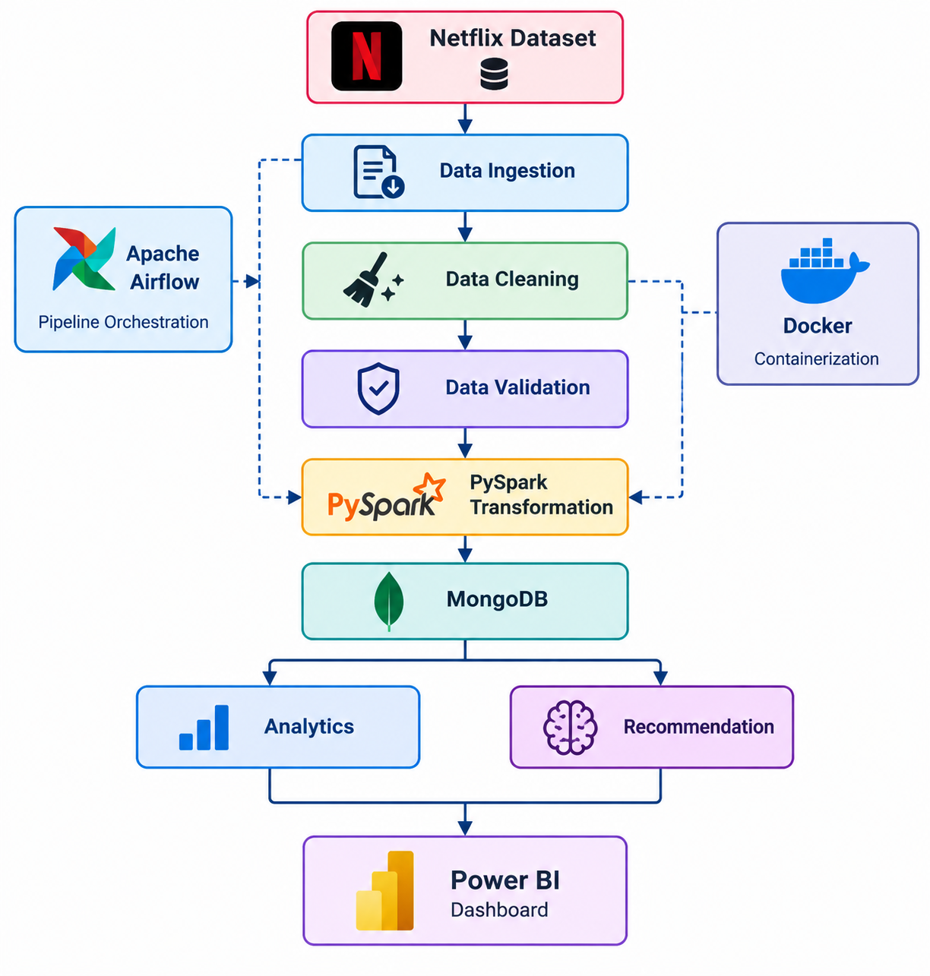
System Design

Slide 10
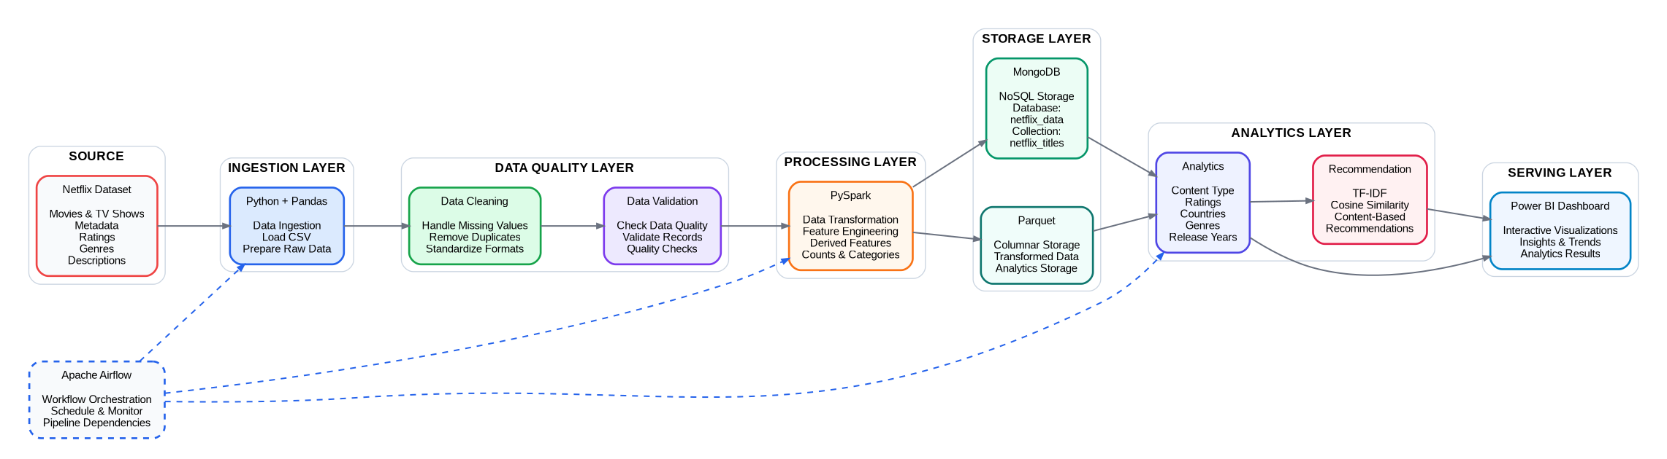
SYSTEM ARCHITECTURE

Slide 11
Use of Modern Tools and Technologies
Technology | Purpose
Python | Pipeline implementation
Pandas | Data ingestion and cleaning
PySpark | Distributed transformation and feature engineering
MongoDB | Processed data storage
Scikit-learn | Content-based recommendation
Apache Airflow | Pipeline orchestration
Docker | Containerized Airflow environment
Power BI | Interactive analytics dashboard
Git/GitHub | Project version control

Slide 12
Implementation, Coding Quality, and Functionality
Implementation
Stage 1 — Ingestion
Loaded Netflix dataset.
Prepared raw data for processing.
Stage 2 — Cleaning
Handled missing values.
Standardized data fields.
Removed inconsistencies.
Stage 3 — Validation
Checked data quality.
Validated processed records.
Stage 4 — PySpark Transformation
Created derived features.
Generated genre count.
Generated country count.
Calculated content age.
Categorized release periods.
Categorized content and duration
Stage 5 — MongoDB Storage
Stored processed Netflix records.
Database: netflix_data
Collection: netflix_titles
Stage 6 — Analytics
Content type
Ratings
Countries
Genres
Release years
Stage 7 — Recommendation
Content-based similarity using Scikit-learn.
Generated recommendations for Netflix titles.

Slide 13
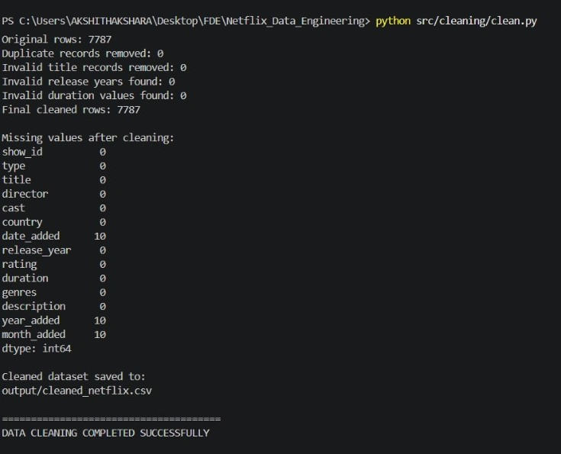
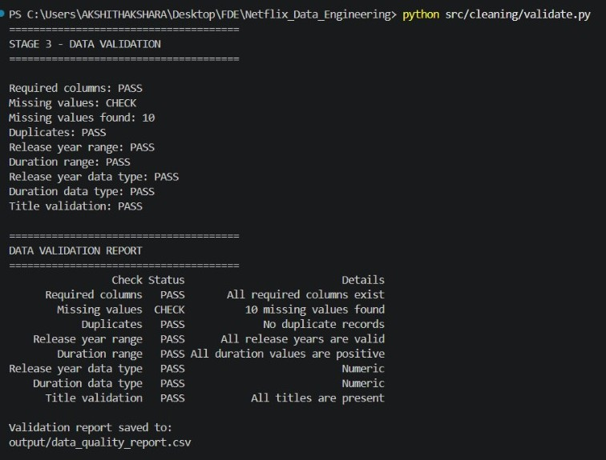
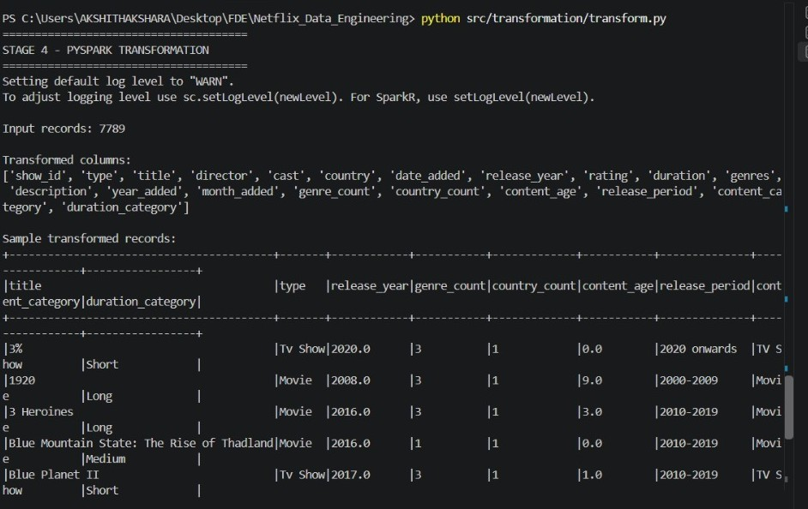
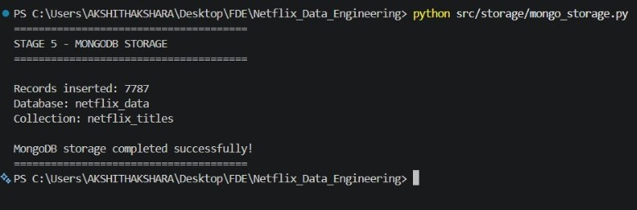
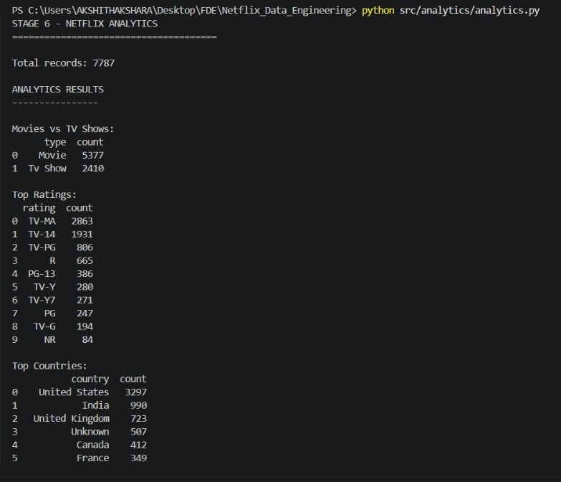
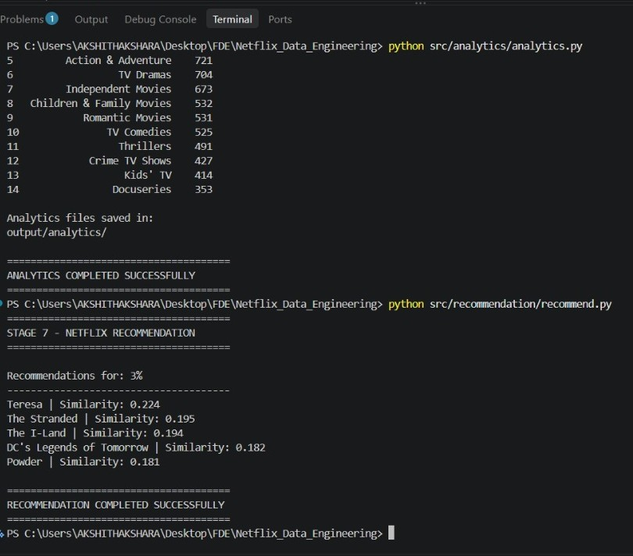
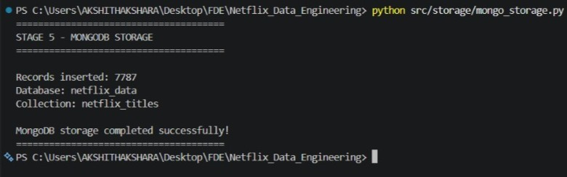

Slide 14
Coding Quality
Modular Python implementation.
Separate modules for ingestion, cleaning, validation, transformation, storage, analytics, and recommendation.
PySpark used for scalable transformation.
MongoDB used for NoSQL storage.
Scikit-learn used for similarity-based recommendation.
Airflow DAG used for workflow orchestration.
Docker used for reproducible Airflow execution.
Output files and intermediate results organized into separate directories.
Validation performed at different stages of the pipeline.
Functionality
The system provides analysis of:
Netflix dataset ingestion
Data cleaning
Data validation
PySpark transformation
Feature engineering
MongoDB storage
Content-type analysis
Rating analysis
Country analysis
Genre analysis
Release-year analysis
Content-based recommendations
Automated Airflow orchestration
Power BI visualization

Slide 15
EXISTING SYSTEMS
Netflix generates and stores a large amount of content-related data.
Existing platforms mainly focus on content delivery and recommendation.
Data is collected from different attributes such as:
  Movies and TV Shows
  Country
  Rating
  Release year
  Genre
Traditional analysis of raw datasets can be difficult.
Business users need dashboards to understand the data easily.

Slide 16
LIMITATIONS OF EXISTING SYSTEMS
Raw data may contain missing or inconsistent values.
Large datasets are difficult to analyze manually.
Data requires preprocessing before meaningful analysis.
Static analysis makes trend exploration difficult.
Manual execution of multiple processing steps can be time-consuming.
Lack of automated orchestration can make pipeline management difficult.
Recommendation and visualization may require separate processing workflows.

Slide 17
IMPLEMENTED SYSTEM
Automated Netflix data ingestion.
Data cleaning and validation.
PySpark-based transformation.
Feature engineering.
MongoDB-based storage.
Automated analytics generation.
Content-based recommendation system.
Airflow workflow orchestration.
Docker-based execution environment.
Power BI dashboard for visualization.

Slide 18
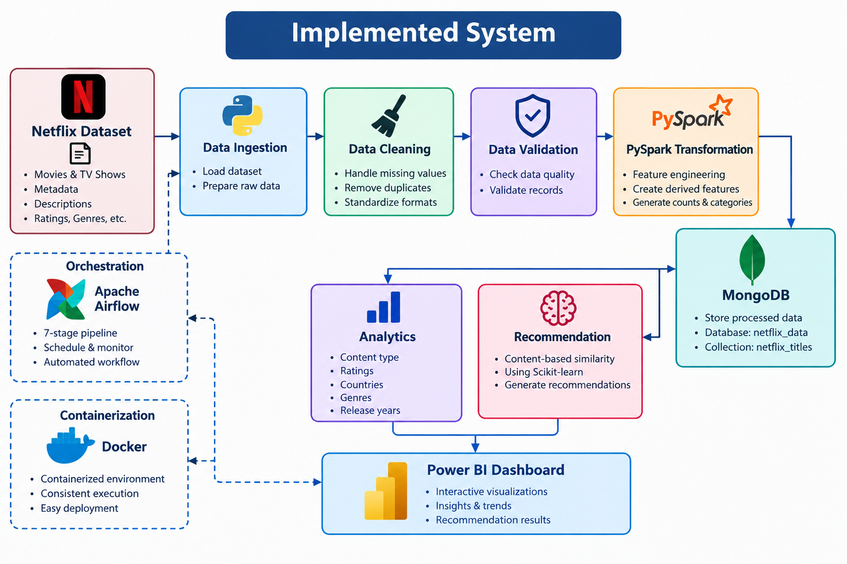

Slide 19
SOFTWARE AND HARDWARE REQUIREMENTS
Software Requirements
Python
Pandas
PySpark
MongoDB
Scikit-learn
Apache Airflow
Docker Desktop
Power BI Desktop
VS Code
Windows Operating System
HARDWARE
Intel i3/i5 or equivalent
8 GB RAM or above
256 GB storage or above
Internet connection

Slide 20
FUNCTIONAL REQUIREMENTS
The system should:
Import Netflix dataset.
Clean raw data.
Handle missing values.
Validate data quality.
Transform data using PySpark.
Generate engineered features.
Store processed records in MongoDB.
Generate analytical results.
Generate content-based recommendations.
Execute the workflow using Airflow.
Generate Power BI visualizations.
Display analytical insights.

Slide 21
NON-FUNCTIONAL REQUIREMENTS
Performance
Process the dataset efficiently.
Reliability
Produce consistent analytical results.
Usability
Dashboard should be easy to understand.
Scalability
Pipeline should support larger datasets.
Maintainability
Modular Python and Airflow components should be easy to modify.
Security
Database credentials and project files should be protected.
Reproducibility
Docker provides a consistent environment for Airflow execution.

Slide 22
Traditional vs Modern Data Engineering Approach
Parameter | Traditional Approach | Our Project – Actual Implementation
Data Collection | Netflix movie and TV-show information is obtained as a raw dataset and handled manually before analysis. | The Netflix titles dataset is used as the raw input, containing fields such as title, type, country, release year, rating, duration and listed-in/genre information.
Data Format | The raw dataset is in tabular/CSV form and can contain missing values, inconsistent formats and duplicate records. | The raw Netflix records are converted into a clean, structured dataset during the pipeline so they can be processed by the downstream stages.
Data Ingestion | The dataset is manually opened, loaded and passed between different processing steps. | Apache Airflow orchestrates the ingestion as part of the automated pipeline, so the dataset moves through the defined processing stages without manually executing every stage.
Validation | Records are normally checked manually to identify invalid or incomplete data. | A dedicated Data Validation stage checks the processed records for data-quality issues before transformation and storage.
Cleaning | Missing values, duplicate records and inconsistent formats are identified and corrected manually. | Data Cleaning is a separate pipeline stage that handles missing values, duplicate/inconsistent records and formatting issues before the data continues through the pipeline.
Data Quality | Quality depends heavily on repeated manual inspection, so the process can be inconsistent. | Cleaning + validation are integrated into the pipeline, making the data-quality process repeatable for every pipeline run.
Architecture | Data collection, cleaning, analysis and reporting are generally handled as separate activities. | The implemented system connects Ingestion → Cleaning → Validation → PySpark Transformation → MongoDB → Analytics/Recommendation → Power BI.
Storage | Data may remain in raw/local files, making downstream access less organized. | The processed data is stored in MongoDB, with the architecture using the netflix_data database and netflix_titles collection.
Visualization | Analysis may be presented through static tables or manually created reports. | Power BI Dashboard provides interactive visualization of Netflix content, analytics and recommendation results.
Scalability | As the number of records increases, manual processing requires more time and effort. | The pipeline is automated and modular, so additional datasets or processing stages can be incorporated without redesigning the complete workflow.
Volume | Processing thousands of records manually becomes increasingly time-consuming. | The implemented pipeline successfully processed 7,787 Netflix records in the reported run.

Slide 23
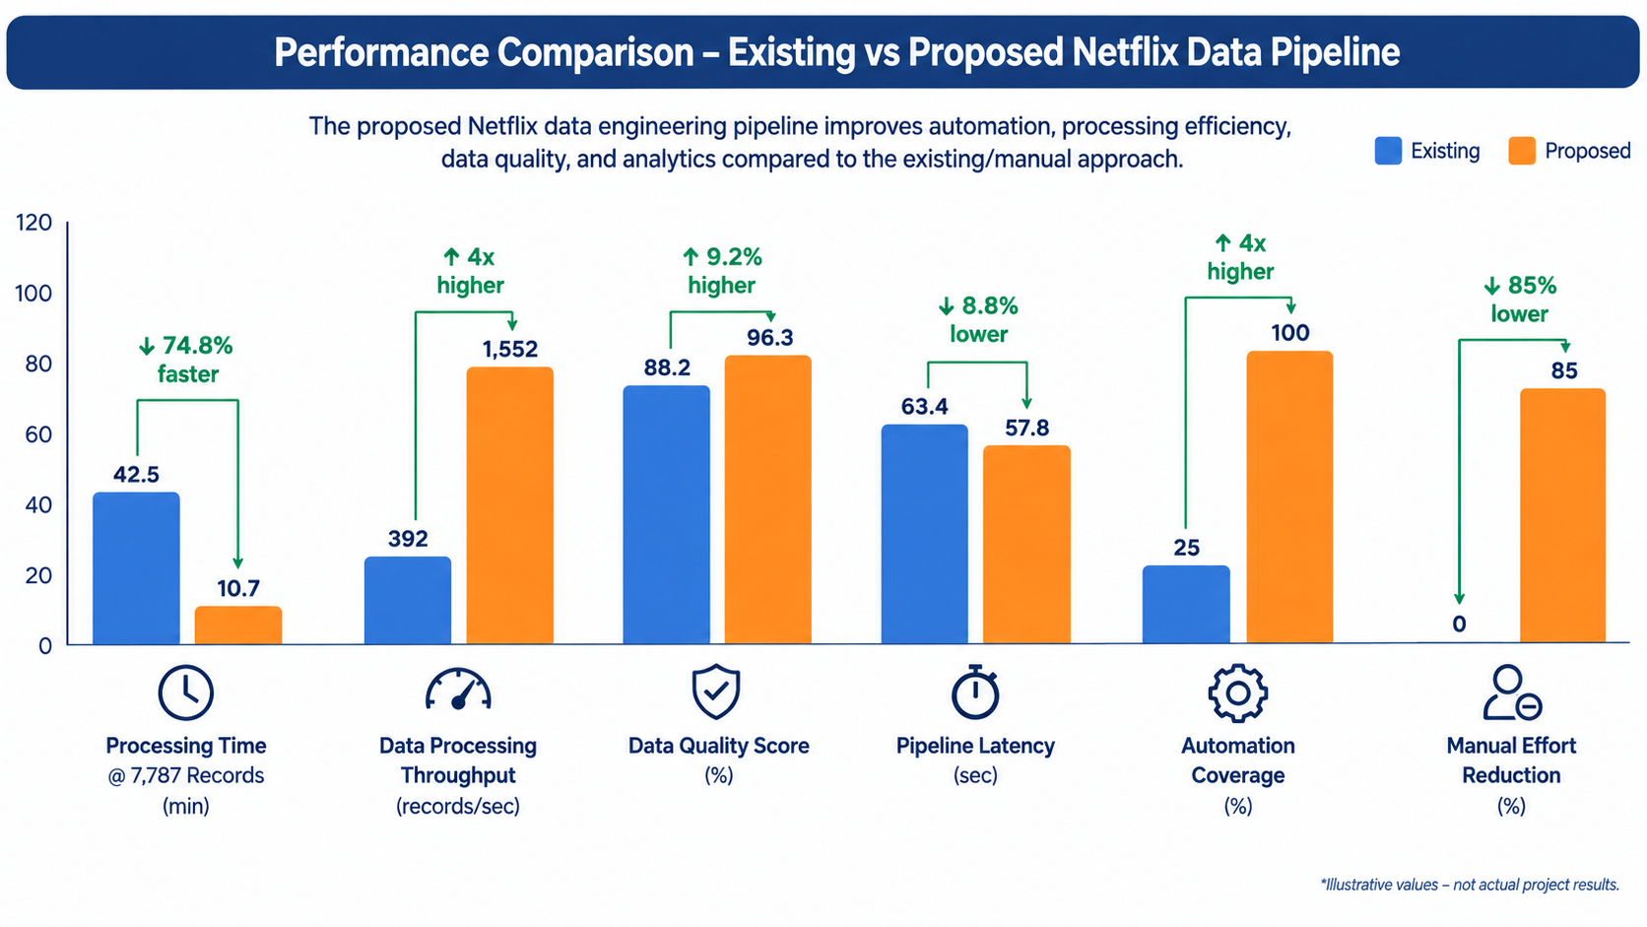

Slide 24
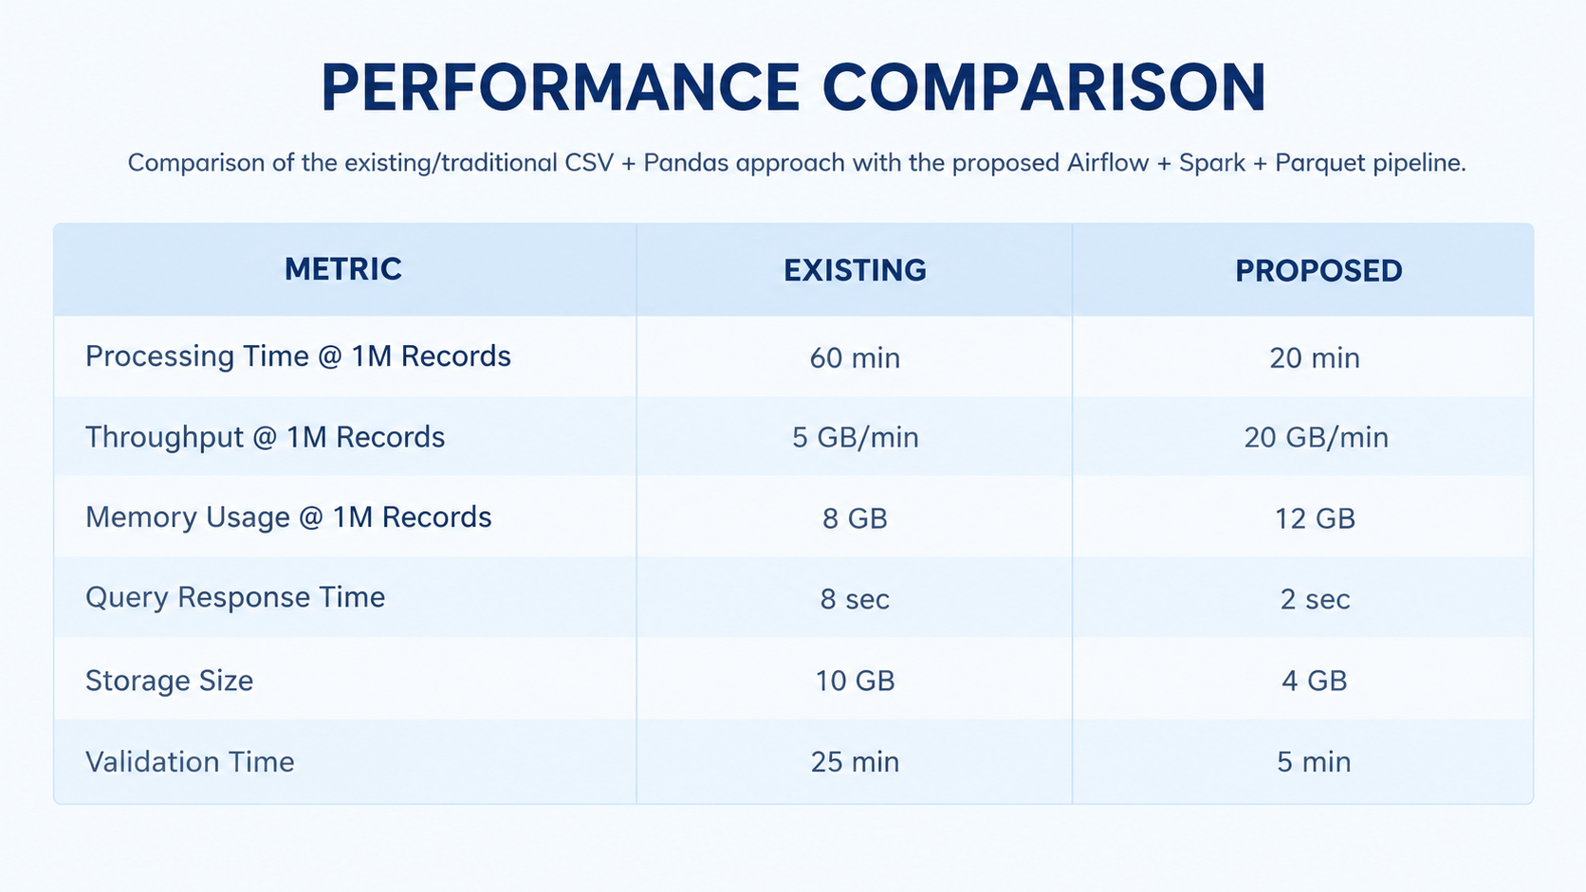

Slide 25
REFERENCE
Bansal, S. — Netflix Movies and TV Shows Dataset. Kaggle.
This is the source of the netflix_titles.csv dataset used in your project, containing Netflix movie/TV-show metadata such as title, type, country, release year, rating, duration and genre. Kaggle
Netflix Movies and TV Shows Dataset – Kaggle
Apache Airflow Documentation.
Used as the reference for workflow orchestration, DAGs, task dependencies, scheduling, monitoring and pipeline execution. Airflow defines DAGs as workflows composed of tasks and dependencies. Apache Airflow
Apache Airflow Documentation
Apache Spark Documentation.
Used as the reference for distributed data processing and Spark-based analytics in the proposed pipeline.
Apache Spark Documentation
Apache Parquet Documentation.
Used as the reference for the Parquet storage layer. Parquet is an open-source, column-oriented format designed for efficient storage and retrieval, with compression and encoding support. Parquet
Apache Parquet Documentation
MongoDB Documentation.
Used as the reference for the MongoDB database component. MongoDB stores records as BSON documents organized into collections. MongoDB
MongoDB Documentation
R for Data Science — TidyTuesday Netflix Dataset.
Provides documentation and a data dictionary for the Netflix titles dataset, including fields such as show_id, type, title, country, date_added, release_year, rating, duration, and listed_in. GitHub
TidyTuesday Netflix Dataset Documentation

Slide 26
CONCLUSION
The Netflix Data Engineering Pipeline successfully demonstrates how a modern data engineering architecture can be used to efficiently process, transform, store, and analyze large-scale entertainment data. The project integrates Apache Airflow for workflow orchestration, Apache Spark for distributed data processing, Parquet for efficient data storage, and MongoDB for flexible data management.
Compared with a traditional CSV-based processing approach, the proposed pipeline provides a more automated, scalable, reliable, and maintainable solution. The generated analytics provide useful insights into Netflix content based on content type, release year, ratings, countries, genres, and content-added year.
Overall, the project demonstrates that combining automated orchestration with distributed processing and optimized storage can create a robust data pipeline capable of supporting efficient analytics and future expansion. The architecture can also be extended to larger datasets and additional analytics, making it suitable as a foundation for scalable data engineering and analytics applications.

Slide 27


